Slide 1



Natural Language Processing with NLTK
Vanessa Gómez Verdejo
Jesús Cid Sueiro
Machine Learning 4 Data Science
Universidad Carlos III de Madrid

Slide 2
Natural Language Processing
Natural Language Processing:
Computer aided text analysis of human language.
The goal is to enable machines to understand human language and extract meaning from text.
It is a field of study which falls under the category of machine learning and more specifically computational linguistics.

Slide 3
Applications
Search engines
Site recommendations
Spam filtering
Knowledge bases and expert systems
Automated customer support systems
Banking fraud detection
Consumer behavior analysis

Slide 4
Challenges to machines.
Sentiment
Ambiguity
Intent
Sarcasm
Slang
Context
Emphasis
Time and date
Since when did “google” become a verb?

Slide 5
NLP with Python
NLTK: A package that provides
basic classes for representing data relevant to Natural Language Processing
Standard interfaces for performing NLP tasks such as tokenization, tagging and parsing
Standard implementation of each task which can be combined to solve complex problems
http://www.nltk.org

Slide 6
NLTK modules
corpora: a package containing modules of example text
tokenize: functions to separate text strings
probability: for modeling frequency distributions and probabilistic systems
stem: package of functions to stem words of text
wordnet: interface to the WordNet lexical resource
chunk: identify short non-nested phrases in text
etree: for hierarchical structure over text
tag: tagging each word with part-of-speech, sense, etc.
parse: building trees over text - recursive descent, shift-reduce, probabilistic, etc.
cluster: clustering algorithms
draw: visualize NLP structures and processes
contrib: various pieces of software from outside contributors

Slide 7
Document Corpus Analysis
Corpus Acquisition
Corpus Processing
Text processing tools:
Natural Language Toolkit (NLTK)
Semantic Analysis
Topic Models: PLSI, LDA

Slide 8
Corpus Acquisition
Corpus Acquisition
Corpus Processing
Text processing tools:
Natural Language Toolkit (NLTK)
Semantic Analysis
Topic Models: PLSI, LDA

Slide 9

Text sources
Any document can be analyzed:
Web content: web pages, twitters, blogs, …
Crawler
Available APIs: wikipedia
Local documents
Available corpus:
NLTK (see http://www.nltk.org/nltk_data/)
scikit-learn, gensim,…

Slide 10
Loading a corpus
From NLTK (pip install nltk)
import nltk
nltk.download()
Mycorpus = nltk.corpus.gutenberg
text_name = Mycorpus.fileids()[0]
raw = Mycorpus.raw(text_name)
Words = Mycorpus.words(text_name)
Install it now and download book content (it takes a while)
[Emma by Jane Austen 1816]
VOLUME I
CHAPTER I
Emma Woodhouse, handsome, clever, and rich, with a comfortable home and happy disposition, seemed to unite some of the best blessings of existence; and had lived nearly twenty-one years in the world with very little to distress
[u'[', u'Emma', u'by', u'Jane', u'Austen', u'1816', u']', u'VOLUME', u'I', u'CHAPTER', u'I', u'Emma', u'Woodhouse', u',', u'handsome', u',', u'clever', u',', u'and', u'rich', u',', u'with', u'a', u'comfortable', u'home', u'and', u'happy', u'disposition', u',', u'seemed', u'to', u'unite', u'some', u'of', …]

Slide 11
Corpus Processing
Corpus Acquisition
Document Processing
Text processing tools:
Natural Language Toolkit (NLTK)
Semantic Analysis
Topic Models: PLSI, LDA

Slide 12
Single document processing
Document
Tokenization
Removing punctuation
Conversion to lowercase
Stemming and lemmatization
Homogeneization
Cleaning
Stopword elimination
Vectorization
Bag of Words model
Feature vector

Slide 13
Tokenization
Tokenization
From text to words (elements inside a sentence):
Homogeneiz.
>> Words = corpus.words(text_name)
>> sentence = “Hola, mundo.”
>> sentence.split()
[‘Hola,’, ‘mundo.’]
>> from nltk.tokenize import word_tokenize
>> word_tokenize(sentence)
[‘Hola’, ‘,’, ‘mundo’, ‘.’]
Cleaning
Vectorization

Slide 14
Homogeneization
Tokenization
EXERCISE 1
Convert every word to lowercase
EXERCISE 2
Remove punctuation
Homogeneiz.
>> clean_text = [w.lower() for w in text]
Cleaning
>> clean_text = [w for w in text
if w.isalnum()]
Vectorization

Slide 15
Homogeneization
Tokenization
The class string in python:
s.find(t) index of first instance of string t inside s (-1 if not found)
s.rfind(t) index of last instance of string t inside s (-1 if not found)
s.join(text) combine the words of the text into a string using s as the glue
s.split(t) split s into a list wherever a t is found (whitespace by default)
s.lower() a lowercased version of string s
s.upper() an uppercased version of string s
s.title() a titlecased version of string s
s.strip() a copy of s without leading or trailing whitespace
s.replace(t, u) replace instances of t with u inside s
t in s test if t is contained inside s
Homogeneiz.
Cleaning
Vectorization

Slide 16
Stemming and Lemmatization
Tokenization
Motivation:
Different forms of a word
organize, organizes, organizing.
Derivationally related words with similar meanings:
democracy, democratic, democratization.
Goal: to reduce inflectional or derivationally related forms of a word to a common base form.
am, are, is ➔be
car, cars, car's, cars' ➔ car
Stemming:
Chops off the ends of words in the hope of achieving this goal correctly most of the time.
See, saw➔ s
Lemmatization:
Usually refers to doing things properly with a vocabulary and morphological analysis of words, aiming to return the base or dictionary form (lemma) of a word.
‘saw’ ➔ ‘see’ if verb, ‘saw’ if noun.
Stemming vs lemmatization
Stemming commonly collapses derivationally related words, whereas lemmatization commonly only collapses the different inflectional forms of a lemma.
Homogeneiz.
Cleaning
Vectorization

Slide 17
Stemming
Tokenization
We count similar words in different variants as different words
We need a function that reduces words to their specific word stem.
Homogeneiz.
Cleaning
import nltk.stem
s = nltk.stem.SnowballStemmer('english')
s.stem(“imaging”) # → u'imag'
s.stem(“image") # → u'imag’
Vectorization

Slide 18
Lemmatization
Tokenization
Lemmatization is a more complex process.
Lemmatization in NLTK uses WordNet.
Homogeneiz.
Cleaning
from nltk.stem import WordNetLemmatizer
>> wnl = WordNetLemmatizer()
>> print(wnl.lemmatize('dogs'))
dog
>> print(wnl.lemmatize('churches'))
church
>> print(wnl.lemmatize('abaci'))
abacus
Vectorization

Slide 19
Lemmatization
Tokenization
With contextual information (the grammatical role of the word) .lemmatize() can filter grammatical differences.
Homogeneiz.
Cleaning
from nltk.stem import WordNetLemmatizer
>> wnl = WordNetLemmatizer()
>> print(wnl.lemmatize(’is'))
is
>> print(wnl.lemmatize(’is’, pos=‘v’))
be
Vectorization

Slide 20
Lemmatization
Tokenization
Part of Speech Tagging.
Part-of-speech (POS) tagging is the process of assigning a word to its grammatical category (noun, verb, adverb,…), in order to understand its role within the sentence.
POS taggers typically take a sequence of words (i.e. a sentence) as input, and provide a list of tuples (word, pos) as output.
POS tagging is what provides the contextual information to .lemmatize() to filter grammatical differences.
Homogeneiz.
Cleaning
>> from nltk import pos_tag
>> s = "This is a simple sentence"
>> tokens = word_tokenize(s)
>> tokens_pos = pos_tag(tokens)
>> print(tokens_pos)
[('This', 'DT'), ('is', 'VBZ'), ('a', 'DT'), ('simple', 'JJ'), ('sentence', 'NN')]
Vectorization

Slide 21
Homogeneization
Tokenization
N-grams
Some words tend to occur in groups
information processing, machine learning…
It can be useful that they are analyzed in groups
There are routines to detect them, but the easiest way is…
informationprocessing
machinelearning
Homogeneiz.
Cleaning
Vectorization

Slide 22
Cleaning
Tokenization
Removing least relevant words
Some words appear very often in all sorts of different contexts.
They are so frequent that they do not help to distinguish between different texts.
These words are called stop words.
The best option would be to remove them
Homogeneiz.
Cleaning
Vectorization

Slide 23
Cleaning
Tokenization
Removing stopwords:
from nltk.corpus import stopwords
sw = stopwords.words('english')
clean_text = [word for word in document
if not word in sw]
Homogeneiz.
Cleaning
Vectorization

Slide 24
Parallel Document Processing
Tokenization
Until now, we have worked with a single document
Extend your code to work with all the documents of the corpus
Create a list of text, where each row is a previously processed text
content = [
[u'fulton', u'counti', u’grand', …, u'said', u’friday’]
[u’austin', u’texa', u’committe', …, u’price', u’abandon’]
….
[u’dear', u’sir', u’let', u’begin', …, u’mind', u’address’]
]
Homogeneiz.
Cleaning
Vectorization

Slide 25
Parallel Document Processing
Tokenization
content = []
for text_name in corpus.fileids():
path = nltk.data.find(
'corpora/brown/'+text_name)
f = open(path, 'rU')
raw = f.read()
# Here you can process your
# raw text → clean_text
content.append(clean_text)
f.close()
Homogeneiz.
Cleaning
Vectorization

Slide 26
Vectorization
Tokenization
Bag of words: counting words
ML algorithms process numbers, not words.
Only if we manage to transform text into meaningful numbers, we can feed it into ML algorithms
Bag-of-word approach: for each word in the document, count its occurrence and note it in a vector
Homogeneiz.
Cleaning
Vectorization

Slide 27
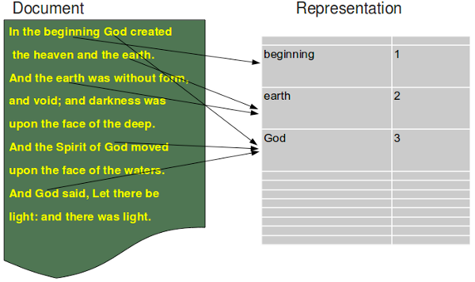
Vectorization
Tokenization
Bag of words: counting words
Homogeneiz.
Cleaning
Vectorization

Slide 28
Vectorization
Tokenization
Bag of words: counting words
[Hadoop, is, great, python, is, great]
Homogeneiz.
Cleaning
[(Hadoop, 1), (is, 2), (great, 2), (python, 1)]
Vectorization
[(12342, 1), (3423, 2), (5676, 2), (6768, 1)]

Slide 29
Vectorization
Tokenization
Term frequency - Inverse document frequency (TF-IDF)
BoW: the feature values simply count occurrences of terms in a document.
High occurrence terms?? They appear in all documents → NON RELEVANT.
Low occurrence terms?? They appear in very few documents → RELEVANT
This can only be solved by:
counting term frequencies for each document
discounting those that appear in many posts
Homogeneiz.
Cleaning
Vectorization

Slide 30
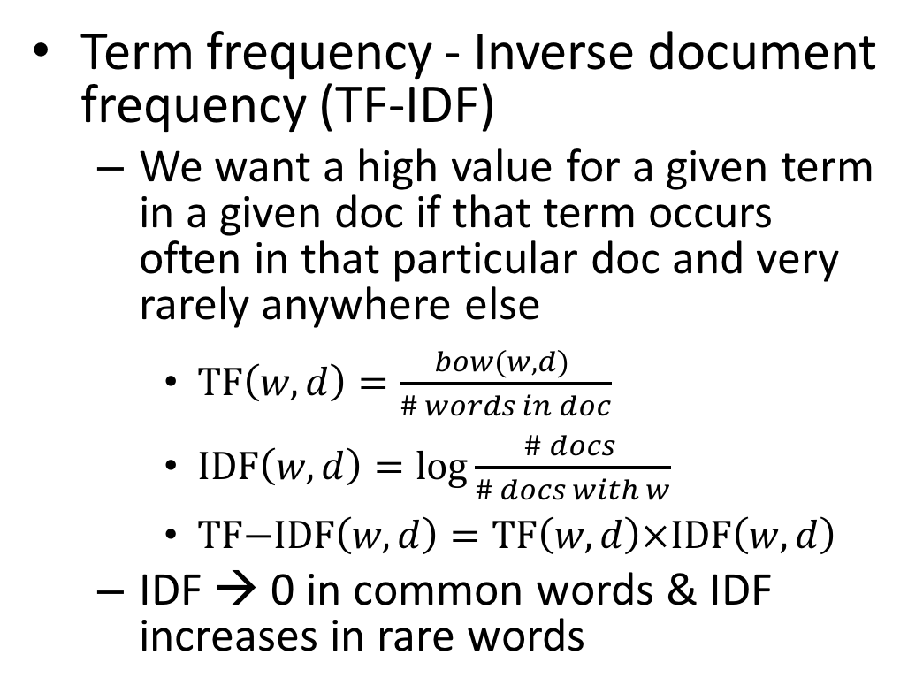
Vectorization
Tokenization
Term frequency - Inverse document frequency (TF-IDF)
We want a high value for a given term in a given doc if that term occurs often in that particular doc and very rarely anywhere else
$\text{TF}\left(w,d\right)=\frac{bow(w,d) }{\# words in doc}$
$\text{I}\text{D}\text{F}\left(w,d\right)=\log{\frac{\# docs }{\# docs with w}}$
$\text{TF}\text{−}\text{IDF}\left(w,d\right)=\text{TF}\left(w,d\right)×\text{ID}\text{F}\left(w,d\right)$
IDF → 0 in common words & IDF increases in rare words
Homogeneiz.
Cleaning
Vectorization

